Slide 1

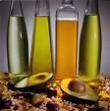
LIPIDS – FATS & OILS

Slide 2
LIPIDS
A lipid is an organic substance found in living systems that is insoluble in water but is soluble in organic solvents.
Lipids vary widely in their structures. They have mostly C,H and some have a few polar atoms/ functional groups.

Slide 3
Lipids include:
fats and oils
steroids
waxes
Fats & oils make up 95% of the nutritional lipids, the other 5% are steroids. Waxes are functional only.
Fats are solid triglycerides
Oils are liquid triglycerides

Slide 4
Fats and Oils
The Triglycerides We Eat
CH₂-O₂C-R
HOCH₂-CHOH-CH₂OH
Fatty acid side chains
CH-O₂C-R’
(glycerol)
CH₂-O₂C-R”
Triglycerides/fatty acids are characterized/named by:
1) The length/number of carbons in the side chains
2) The number of carbon-carbon double bonds in the side chains(the degree of unsaturation).

Slide 5
Representative Fatty Acids
C12-C18(also C20) Dietary Fats and Oils
CH₃-(CH₂)₁₂-COOH
CH₃-(CH₂)₁₄-COOH
CH₃-(CH₂)₁₆-CO₂H
CH₃-(CH₂)₇-CH=CH-(CH₂)₇-CO₂H
CH₃-(CH₂)₄-CH=CH-CH₂-CH=CH-(CH₂)₇-CO₂H
CH₃-CH₂-CH=CH-CH₂-CH=CH-CH₂-CH=CH-(CH₂)₇-CO₂H
(1)
(2)
(3)
(4)
(5)
(6)
Name
Mp(ºC)
Class
(1) Myristic acid 58 Saturated C-14
(2) Palmitic acid 63 Saturated C-16
(3) Stearic acid 71 Saturated C-18
(4) Oleic acid 4 Monounsaturated C-18
(5) Linoleic acid - 5 Polyunsaturated C-18
(6) Linolenic acid - 11 Polyunsaturated C-18

Slide 6
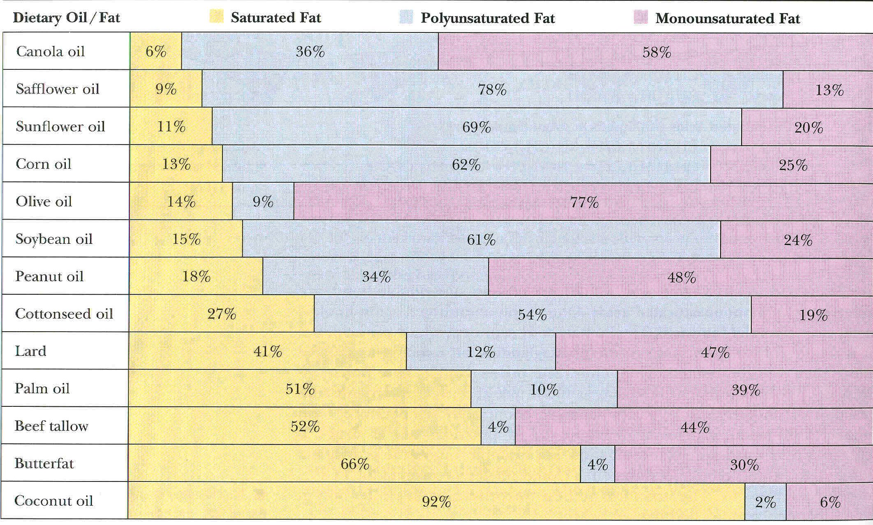
Fatty Acid Content of some Fats/Oils

Slide 7

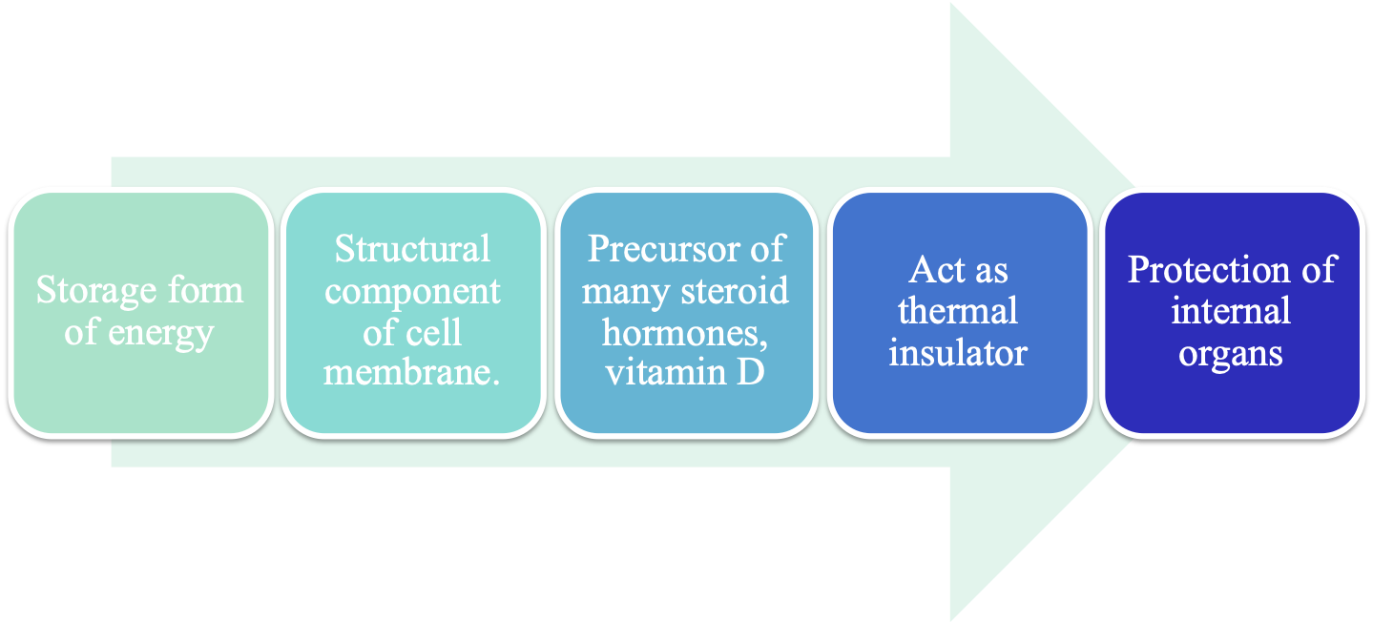

Slide 8

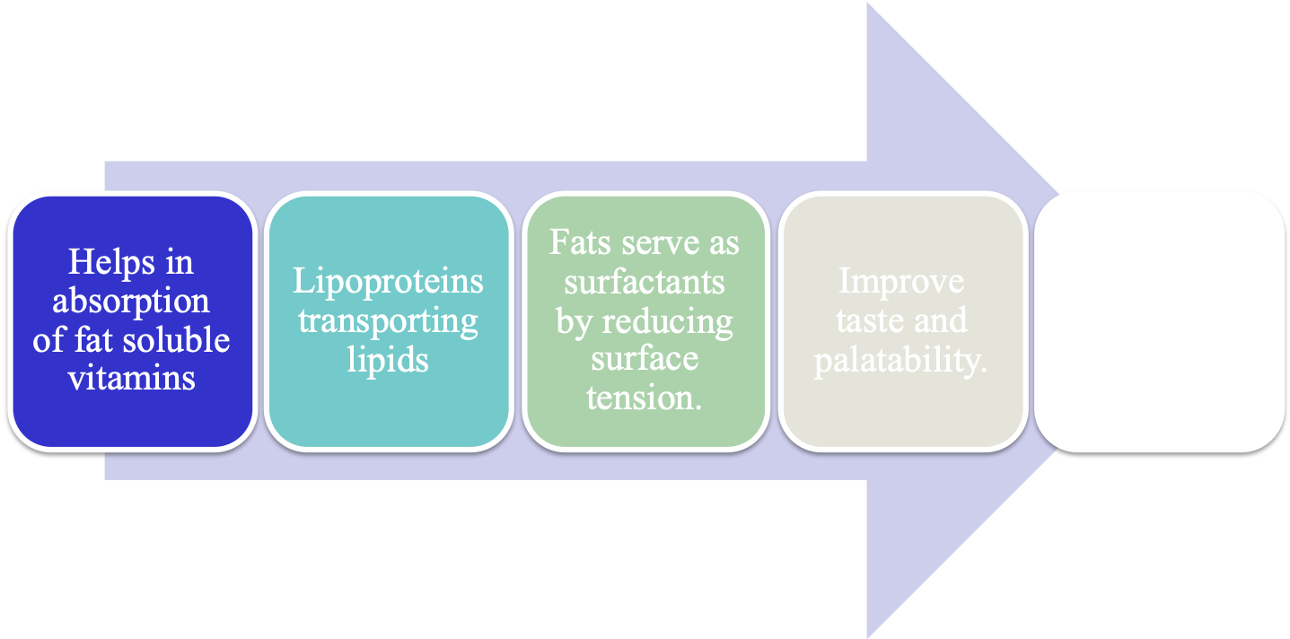

Slide 9
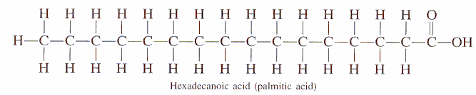
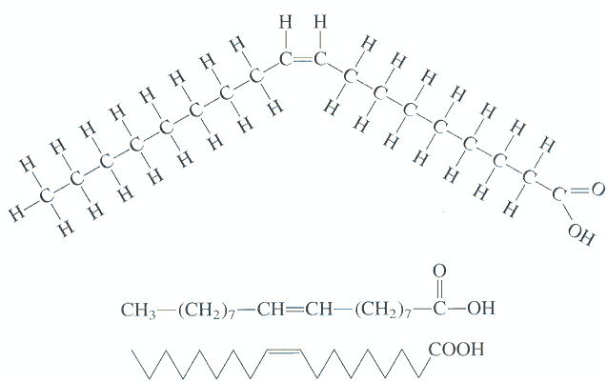
Saturated fatty acid : Fatty acid chains that contain only carbon-carbon single bonds are referred to as saturated (Palmitic acid)
Unsaturated fatty acid : Those molecules that contain one or more double bonds are said to be unsaturated. There are mono- and polyunsaturated fatty acids (Oleic acid)

Slide 10

Canola (Canadian-oil-low acid)
Oil from Canadian rapeseed
Has “ideal ratio” of omega-6 to omega-3 fatty acids of 2:1
Also very low in saturated fat

Slide 11

Olive oil
Deemed to be the most “heart healthy”
Highest % of monounsaturated fatty acids
Extra virgin (1st press)

Slide 12
Oxidation of Organic Compounds, eg. fatty acids
O2 -C-C-C-COOH -C-COH-C-COOH saturated difficult
O2 -C=C-C-COOH -COH-COH-C-COOH unsaturated easy
oxidation = decomposition = rancidity
more saturated = more stable, ie. longer ‘shelf life’, eg. commercial baked goods more unsaturated = faster deterioration, ie. need antioxidants to protect compounds(in the body?)

Slide 13
FATTY ACIDS (TRIGLYCERIDES)
Solid: longer chains
saturated(only C-C)
eg. animal fat, butter
Liquid: unsaturations (C=C)
eg. many vegetable oils
(olive, sunflower)

Slide 14
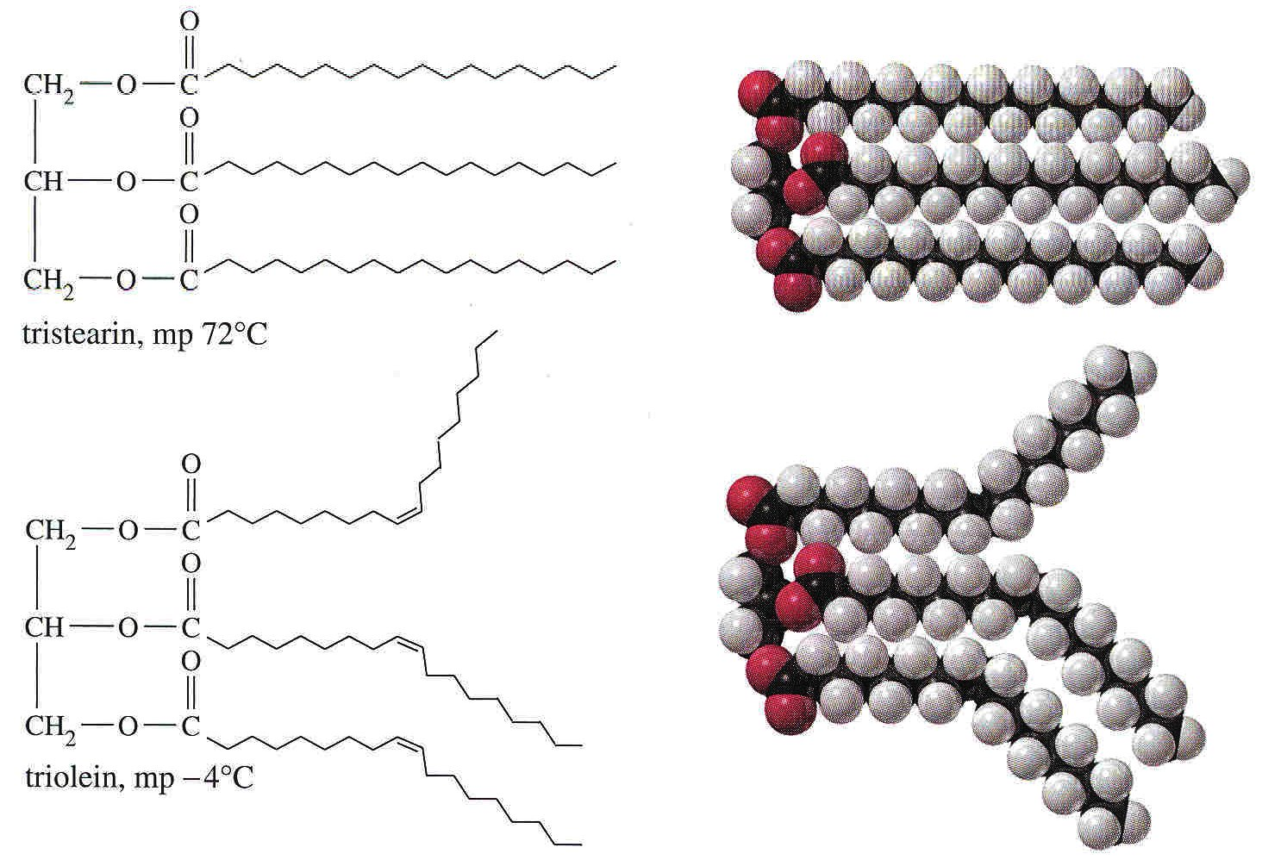
Unsaturates can’t fit well into a solid lattice

Slide 15
Body fat is stored energy
The body converts the unused carbohydrates, proteins and triglycerides that make up our macronutrients into small globules of fat that end up in the specialized cells of adipose tissue, the fatty tissue of the body.
One pound of adipose tissue stores, and provides when needed, ~3500 Cal of energy.

Slide 16
The high energy density of fat - its ability to store energy (9 Cal/gram) compactly in relatively little space and with relatively little weight, compared with carbohydrates and proteins (4 Cal/gram), allows us to carry stores of energy with us.
It give humans and other animals the mobility and freedom necessary for survival

Slide 17
Fat = Essential Energy
Most of our long term energy supplies operates via the formation, storage and metabolism of body fat (triglycerides).
Short term energy storage, from one meal to another, occurs through a starch-like substance called glycogen(a carbohydrate).

Slide 18
Omega-3 eggs
Chickens are fed flaxseed, which contains high levels of omega-3 fatty acids. After 10 days, this modifies the fat content in the egg yolk to contain more omega-3 fatty acids and less saturated and omega-6’s
In 1997, this was the Canadian New Product of the year

Slide 19
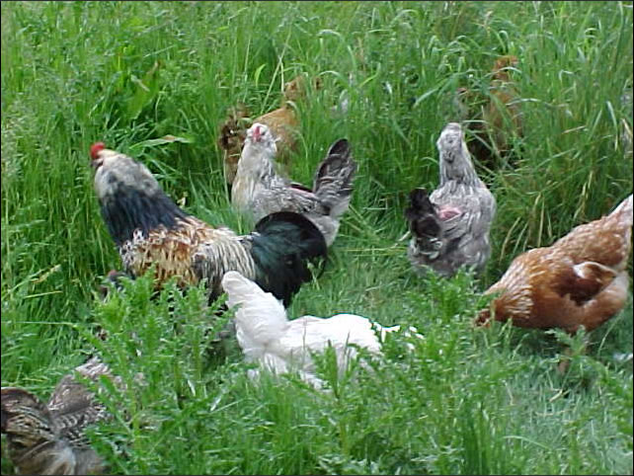
Omega-3 Chickens

Slide 20
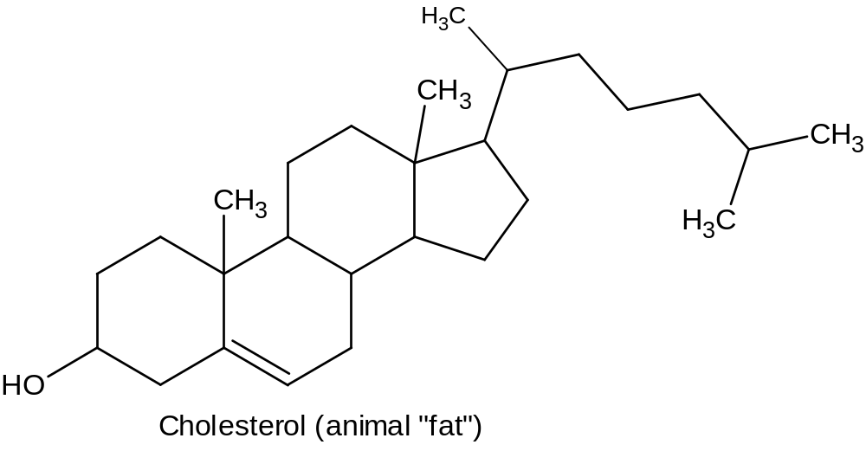
Cholesterol - a steroidal alcohol (atherosclerosis!)
High – red meat, egg yolks, dairy products Low – egg whites, yoghurt
None ! – fruits, veggies, vegetable oils

Slide 21
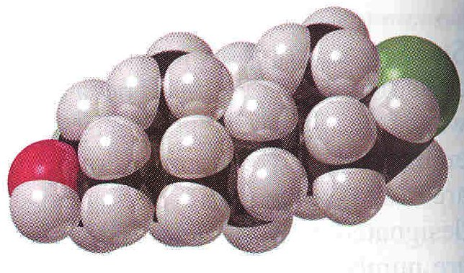
Properties of Cholesterol
very insoluble in water, C₂₇H₄₆O
solid, mp. 149º
compact, stiff/rigid

Slide 22
Lipid Content (mg) per serving of common foods
Includes cholesterol
Saturated fatty acids
Unsaturated fatty acids

Slide 23
Lipid Content (mg) per serving of common foods
Includes cholesterol
Saturated fatty acids
Unsaturated fatty acids

Slide 24
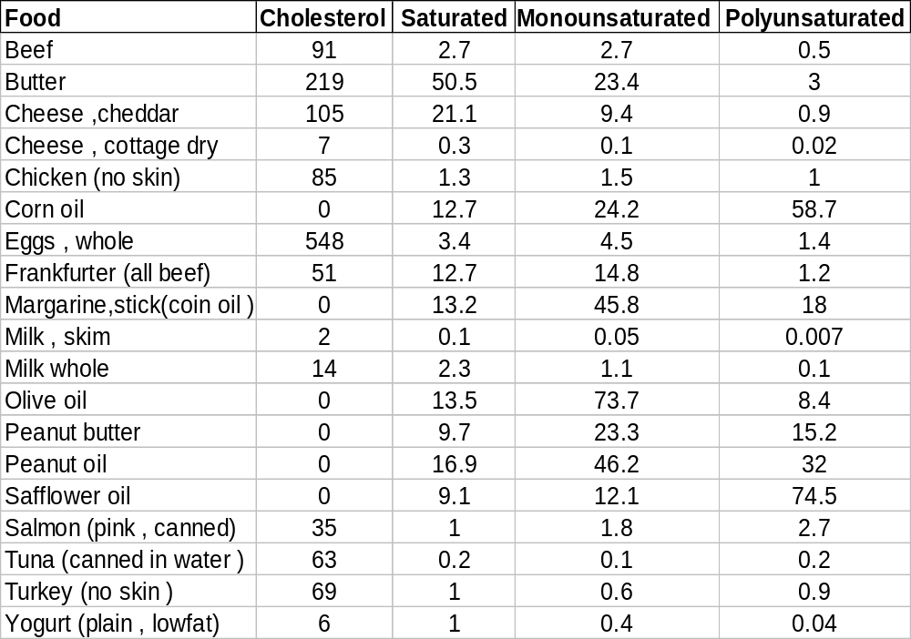
Fat and Oil Content

Slide 25
Note
No cholesterol in products derived from plant sources!!

Slide 26
Cholesterol Related compounds
7-dehydrocholesterol (functions as a cholesterol precursor in blood serum) gets converted in vivo (epidermal cells) to Vitamin D by the action of sunlight

Slide 27
Are you getting enough Vitamin D?
Deficiency leads to poor teeth and bone development (rickets) in children
Vitamin D is added to milk to offset lack of sunlight in winter ; aids in Ca absorption
Darker skin prevents UV action
Some MS connection (2009)-all people should be taking supplements of it.

Slide 28
Can one get too much Vitamin D?
Yes-overuse of Vitamin D supplements can lead to excessive absorption of Calcium and formation of Ca deposits in kidneys
Exposure to sunlight is not a problem; Melanin formation (tanning) stops the UV induced reaction
Recent claims re: Cancer retardation are controversial

Slide 29
Conclusions?
Drink your milk (and less carbonated sodas)
Take cod liver supplements if no exposure to sunlight
Some exposure to sunlight is good (~1 hour per day)
Avoid mega doses of any fat soluble vitamin

